Slide 1
Software Metrics
Fundamentals of Measurements and Experimentation

Slide 2
SOFTWARE METRICS
TEXT BOOK
Title : Software Metrics
Author : Norman E. Fenton and Share Lawrence Pfleeger
Publisher : International Thomson Computer Press, 2003.
Edition : Thomson Delmar 2nd edition.

Slide 3



Slide 4
SOFTWARE METRICS
REFERENCE BOOK
Title : Metric and models in software quality engineering
Author : Stephen H.Kin
Publisher : Addison Wesley 1995 Pearson Education 2003
Edition : Thomson Delmar 2nd edition.
William A. Florac and Areitor D.Carletow,
“Measuring Software Process ", Addison Wesley, 1995.

Slide 5
CONTENTS
I . Fundamentals of Measurements and Experimentation
II . Software Engineering Measurement
III . Measurement and Management

Slide 6
Objective
Overview of software metrics
The basics of measurement
Framework of software measurement
Empirical Investigation

Slide 7
Content
What is measurement
What are the software metrics?
Scope of software engineering metrics: a chronological review.

Slide 8
Key Points
Metric - A quantifiable characteristic of software.
Measurement - The process of mapping from real world attributes to a mathematical representation.
Model - A mathematical relationship between metrics.

Slide 9
Why Measure?
The primary purpose of a measurement
program should be to helping project managers make project decisions.
You can’t manage what you can’t measure!
If you are not measuring, then how are you managing?

Slide 10
What is Measurement
Measurement is the process by which numbers or symbols are assigned to attributes of entities in the real world in such a way as to describe them according to clearly defined rules
entity:-object(person or room)
Event- Journey or testing phase of a software project)
Attribute- property of an entity(color of room , cost of journey)

Slide 11


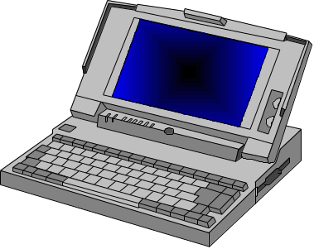
Measurement Defined
Entity:
Attribute:
Features & Properties
Mapping:
Numbers
&
Symbols

Slide 12
Measurement Example
8
7
6
5
4
3
2
color of marbles
(attribute) of (entity)
mapping is
the measurement
1
numerical representation
of the attribute “color”

Slide 13
Motivation for Metrics
Estimate the cost & schedule of future projects
Evaluate the productivity impacts of new tools and techniques
Establish productivity trends over time
Improve software quality
Forecast future staffing needs
Anticipate and reduce future maintenance needs

Slide 14
What is Software Metrics
Provides values and units for describing software attributes

Slide 15
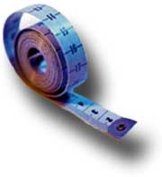
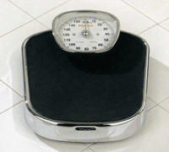
Why Measure Software?
Helps in:
- Comparing multiple approaches
- Estimating manpower/time required
- Find complex components in a system
- Predict quality

Slide 16
Measuring for Understanding, Control and Improvement
Measure help us for following three activities
  Understand what happen during development and maintenance.
  Control what happen on the project , predict what happen and make changes to meet our goal.
  Based on the design quality Improve the process and product.

Slide 17
Measurement in Everyday Life
How do we use measurement in our lives?
  In a shop, price is a measure of the value of an item, and we calculate the bill to make sure we get the correct change.
  Height and size measurements ensure clothing will fit correctly.
  When traveling, we calculate distance, choose a route, measure speed, and predict when we’ll arrive
Measurement helps us to:
  Understand our world
  Interact with our surroundings
  Improve our lives

Slide 18
Some aspect descriptor allows us to compare it with others(calculation are done with set of rules)
Price=one item with other
Distance=distance travel to distance remaining

Slide 19
Measurement in Everyday Life
Making Things Measurable
  “What is not measurable, make measurable” (Galileo Galilei)
    One aim of science is to find ways of measuring attributes of things we’re interested in.
    Measurement makes concepts more visible, therefore more understandable and controllable.
    Attributes previously thought to be unmeasurable now form basis for decisions affecting our lives (e.g., air quality, inflation index).
  Measuring the unmeasurable improves understanding of particular entities, attributes
    Act of proposing a particular measure can open discussion that will lead to greater understanding
    Making new measurement may requiring modifying environment or practices (e.g., using a new tool, adding a step in a process)

Slide 20
Role of Measurement
Understand
Control
Processes,
Products &
Services
Evaluate
Predict

Slide 21
Measurement in Everyday Life
It helps us to understand our world,interact with our surroundings and improve our lives.
  Economic indicators determine prices, pay raises
  Medical system-diagnose specific illness
  Atmosphere-weather prediction
  Journey-calculate distance,speed

Slide 22
Making Things Measurable
Measurement:-direct quantifiation.eg-height of the tree
Calculation:- indirect, quantification.
eg-city inspectors assign a valuation to a house. factors-number of rooms , overall floor space.
Two kinds of quantification:
  Measurement
  Calculation

Slide 23
Metric Classification
Products
  Explicit results of software development activities
  Deliverables, documentation, by products
Processes
  Activities related to production of software
Resources
  Inputs into the software development activities
  hardware, knowledge, people

Slide 24
Types of Measures
Direct Measures (internal attributes)
  Cost, effort, LOC, speed, memory
Indirect Measures (external attributes)
  Functionality, quality, complexity, efficiency, reliability, maintainability

Slide 25
Size-Oriented Metrics
Size of the software produced
LOC - Lines Of Code
KLOC - 1000 Lines Of Code
SLOC – Statement Lines of Code (ignore whitespace)
Typical Measures:
  Errors/KLOC, Defects/KLOC, Cost/LOC, Documentation Pages/KLOC

Slide 26
LOC Metrics
Easy to use
Easy to compute
Language & programmer dependent

Slide 27
Software Metrics
An indirect measure involves a measure and a prediction formula.
For example, you cannot calculate density directly. First you measure mass and volume, then you can calculate density=Mass/Volume.

Slide 28
Software Metrics
In computer science, many of the “ilities” cannot be measured directly. These include:
maintainability
complexity
readability
(another non-“ility”)
testability
quality
(not a true “ility”)
reusability

Slide 29
Some measures used in SE
Entity
Attributes
Measures
Completed project
Duration
Months from start to finish
Completed project
Duration
Days from start to finish
Program code
Length
Number line of code (LOC)
Program code
Length
Number of executable statements
Integration testing process
Duration
Hours from start to finish
Integration testing process
Rate at which faults are found
Number of faults found per KLOC
Tester
Efficiency
Number of faults found per KLOC
Program code
Reliability
Rate of occurrence of failure in CPU time

Slide 30
Direct & Indirect Measurement
Direct measurement of an attribute of an entity involves no other attribute or entity
  Length of source code (measured by LOC)
  Duration of testing process (measured by elapsed time in hours)
  Number of defects discovered during the testing process (measured by counting defects)
  Time a programmer spends on a project (measured by weeks works)

Slide 31
Indirect Measurement
Programmer productivity
LOC produced
Person month of effort
Number of defects
module size
Module defect density
Number of defect detected
total number of defects
Defect detection efficiency
Requirement stability
number of initial requirement
Total number of requirement
Test effectiveness ratio
Number of items covered
Total number of items
System Spoilage
Effort spent fixing faults
total project effort

Slide 32
Measurement in Software Engineering
Why measurement in software engineering.
SE activities include managing, costing, planning, modeling, analyzing, specifying, designing, implementing, testing and maintaining.
Engineering approach-each activity is understood and controlled.
CS provides the theoretical foundation for building software.
SE focuses on implementing the software in a controlled and scientific way.

Slide 33
Importance of SE
Used in
  oven,
  banking transaction
  Air traffic control
  Sophisticated power plants
  Weapons
  Quality of life depends on software
  Worse-too many stories about software that put lives and businesses at risk.

Slide 34
Software Metrics
The following are criteria for valid metrics:
1. A metric must allow different entities to be distinguished.
2. A metric must obey a representation condition.
A representation condition is the condition that the rules assigning the metric properly characterizes the attribute measured.

Slide 35
Software Metrics
3. Each unit of the attribute must contribute an equivalent amount to the metric.
For example, if we are counting lines of code, the attribute would be “lines of code” and we do not give different weights to different lines of code. Each line counts “one”.

Slide 36
Software Metrics
4. Different entities can have the same attribute values.
For example, horses and people both have the attribute “height” which can be “measured” using a “metric”.

Slide 37
Software Metrics
Many times the attribute of interest is not directly measurable.
In this case an indirect measure is used.
For example, you can’t directly measure the temperature on the surface of the sun, so an indirect measure is used.

Slide 38
Measurement in other Engineering Discipline
Eg-Designing electrical circuits-theories ohm law, describes the relationship between resistance, current and voltage in the circuit.
Measuring the changes in behavior, measuring the cause and effect.
Build the circuit with specific current and resistance ,we know voltage is required
Its difficult to imagine electrical, mechanical and civil engineering without measurement

Slide 39
Measurement in SE
Before measurement project can be planned
  Objective and scope should be established
  Alternative solution should be considered
  Technical and management constraints should be identified
This information is required to estimate costs, project tasks and project schedule.

Slide 40
Objectives for Software Measurement
Measurement is not only useful but necessary.
How can you tell if your project is healthy if you have no measures of its health?
So measurement is needed at least or assessing the status of your projects, products, process and resources.
Measurement action is motivated by a particular goal.

Slide 41
Kind of Information need to Manager
What does each process cost?
  Eliciting requirements, specifying,designing,coding and testing.

Slide 42


Productivity of staff
How productive is the staff?
  Manger figure out, how productive the staff is at each activity.

Slide 43
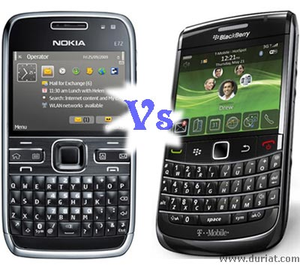
How good is the code being developed?
  Measure software quality, compare different products, predict the effect of changes.

Slide 44

Will the user be satisfied with the product?
  Requirement requested have actually been implemented properly

Slide 45
How can be improve?
  Compare two design method to see which one yields the higher quality code.

Slide 46
Engineers
Are the requirement testable?
  Analyze each requirement –reliable
Have we found all faults?
  Measure the number of faults and find the root causes
Have we met our product or process goal?
  Measure characteritics of products and process-met standards(certification, eg-no module contain more than 100 lines of code)
What will happen in the future?
  Measure the existing and current product and predict the future.

Slide 47
Measuring for Understanding, Control and Improvement
Measure help us for following three activities
  Understand what happen during development and maintenance.
  Control what happen on the project , predict what happen and make changes to meet our goal.
  Based on the design quality Improve the process and product.

Slide 48
Role of Measurement
Understand
Control
Processes,
Products &
Services
Evaluate
Predict

Slide 49
The Scope of Software Metrics
Cost and effort estimation
Productivity measures
Data collection
Quality models and measures
Reliability models
Performance evaluation and models
Structural and complexity metrics
Capability-maturity assessment
Management by metrics
Evaluation of methods an tools

Slide 50
1.Cost and Effort Estimation
Manger role
  Predict the project cost and time in planning stage.
  Cost estimation models like
    COCOMO.
    Putnam’s.
    SLIM model.
    Effort is measured by
    - Size of the product, capability of developers , level of reuse
    Size id measured by
    Lines of code or Function point

Slide 51
2.Productivity Models and Measures
The rate of output per unit of input
Productivity=size/effort
Productivity=LOC/person-month
Productivity--------→Value
  Cost

Slide 52
Productivity
Productivity
Value
Cost
Personnel
Resources
Complexity
Quality
Quantity
Time
HW
Env Cnstrst
Problem difficulty
Reliability
Defects
Size
Functionality
Money
SW

Slide 53
3.Data Collection
Quality of measurement program dependent on data collection.
Data collection must be planned and executed in a careful and sensitive manner.
Its essential for scientific investigation of relationship and trends.
Eg-software failure data collection
  Time of failure
  Time interval between failures
  Cumalative failure up to a given time.
  Failure experienced in a time interval

Slide 54
4.Quality Models and Measures
Assessment of product quality, speed of production is meaningless.
Quality combined with productivity.
Measure the factor in terms of dependent criteria
  Eg-shirt material

Slide 55
Quality Models and Measures
Upper branches-high-level quality-quantify
Lower-level –structuredness and traceability Quality factor
Use
Factor
Criteria
Usability
Communicativeness
Product Operation
Accuracy
Reliability
Consistency
Efficiency
Device Efficiency
Accessibility
Reusability
Metrics
Completeness
Product Revision
Maintainability
Structuredness
Portability
Conciseness
Device Independence
Testability
Legibility
Self-descriptiveness
Traceability

Slide 56
5.Reliability Models
Most quality models include reliability as a component factor.
The most famous model are basic exponential model and logarithmic poisson model.
  Exponential model assumes Finite failure in infinite time
  Logarithmic Poisson Model-infinite failure

Slide 57
6.Performance Evaluation an Models
Performance is another aspect of quality.
Response time and completion rates.
Efficiency of algorithm

Slide 58
7.Structural and Complexity Metrics
Quality like reliability and maintainability cannot be measured until code is available.
We able to predict which part of software system less reliable , more difficult to test , even before the system is complete.
In advance we try to establish, predictive theories to support quality assurance , quality control , quality prediction.

Slide 59
Structural and complexity Metrics
Complexity metric
  Cyclomatic complexity(McCabe 1989)-defining the number of independent path in execution of a program.

Slide 60
8.Management by Metrics
Measurement is important in SPM.
Customer and developer rely on, measurement based charts and graphs to decide If the project is on track.
Project can be compared and contrasted ,by standards of measurement and testing report.
Customer is not well-versed In software terminology, so measurement can paint a picture of progress in general,understandable terms

Slide 61
9.Evaluation of Methods and Tools
Many article and book describe new methods and tools , that make more productive and your products better and cheaper.
Many org perform experiment ,run case studies or administrative survey to help them decide whether a method a tool is make a positive difference in particular situation.
Success depends on good experiemental

Slide 62
10.Capability Maturity Assessment
US Software Engineering Institute (SEI) model (1989):CMM grading using five-level scale for software development and maintenance.
Level 1-Initial
Level 2-Repeatable
Level 3-Defined
Level 4-Managed
Level 5- optimizing

Slide 63
Determining what to measure
The SEI has suggested that there are five levels of process ranging from ad hoc, repeatable, defined, managed and optimizing.
The SEI distinguishes one level from another in terms of key process activities going on at each level.
Overview of process maturity and measurement
Maturity level | Characteristics | Type of metrics to use
5. Optimizing | Improvement feedback to the process | Process plus feedback for changing the process
4. Managed | Measured process | Process plus feedback for control
3. Defined | Process defined and institutionalized | Product
2. Repeatable | Process dependent on individuals | Project management
Initial | Ad hoc | Baseline

Slide 64
Level 1 : Initial Inputs to the process are ill-defined; while outputs are expected, the transitions from inputs to outputs is undefined and uncontrolled. Similar projects may vary widely in their productivity and quality characteristics because of lack of adequate structure and control. Baseline measurements are needed to provide starting point for measuring improvement as maturity increases.

Slide 65
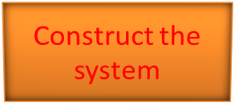
Level 2: Repeatable It identifies the inputs and outputs of the process, the constraints and the resources used in the final product. The process is repeatable: proper inputs, proper outputs, but there is no visibility into how the outputs are produced
Control
(Budget Schedule Standards)
Input Requirements
Output code Documentation
Resources (Staff Tools)
A Repeatable process

Slide 66
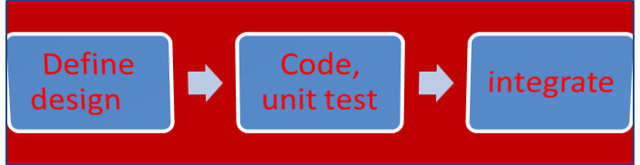
Level 3 : Defined The defined process provides visibility into the “construct the system” box In this level the intermediate activities are defined and their inputs and outputs are known and understood. All process can be examined, measured and assessed. A defined process
Design Method
Inspection criteria
Test Plans
Requirements
System S/W
Tools, Staff
Tools, Staff
Tools, Staff

Slide 67
Level 4: Managed A managed process adds management oversight to a defined process. You can compare contrast, the effects of changes in one activity can be traced in the others. The feedback determines how resources are deployed. You can evaluate the effectiveness of process activities: how effective are reviews? Configuration management? Quality assurance?. A significant difference between level 3 and 4 is that level 4 measurements reflects characteristics of the overall process and of the interaction among and across major activities. Management oversight relies on a metrics database that can provide information about such characteristics as distribution of defects, productivity and effectiveness of tasks, allocation of resources, and the likelihood that planned and actual values will match.

Slide 68
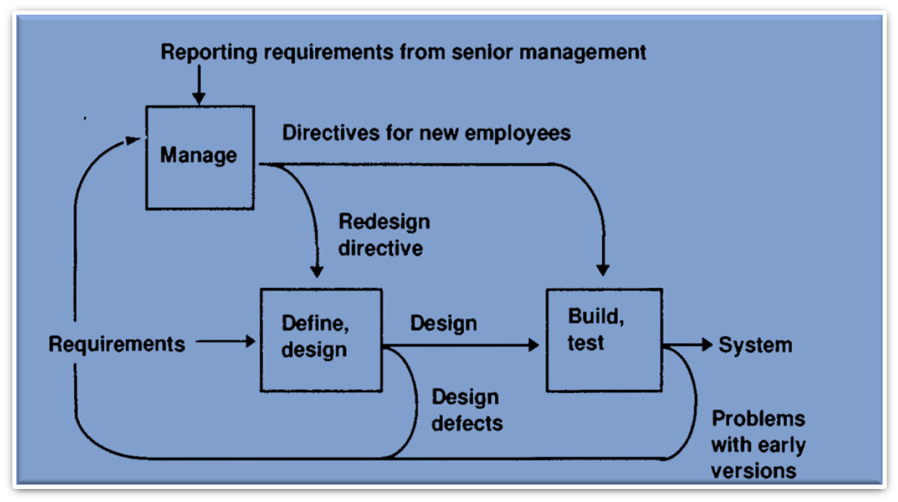
A managed process (Level 4)

Slide 69
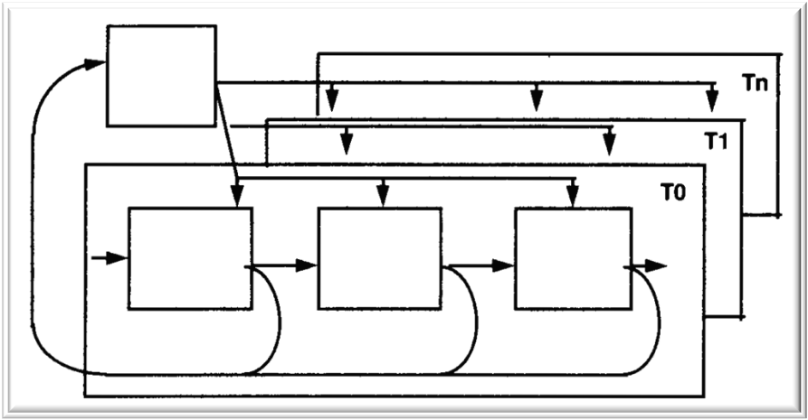
Level 5 : Optimizing Here measure from activities are used to improve process, possibly by removing and adding process activities, and changing the structure dynamically in response to measurement feedback. An optimizing process (Level 5)

